Slide 1
CMP3005 Analysis of Algorithms Term Project
Barış Mumyakmaz
E. Burak Tokman
Sertaç Bağcı

Slide 2
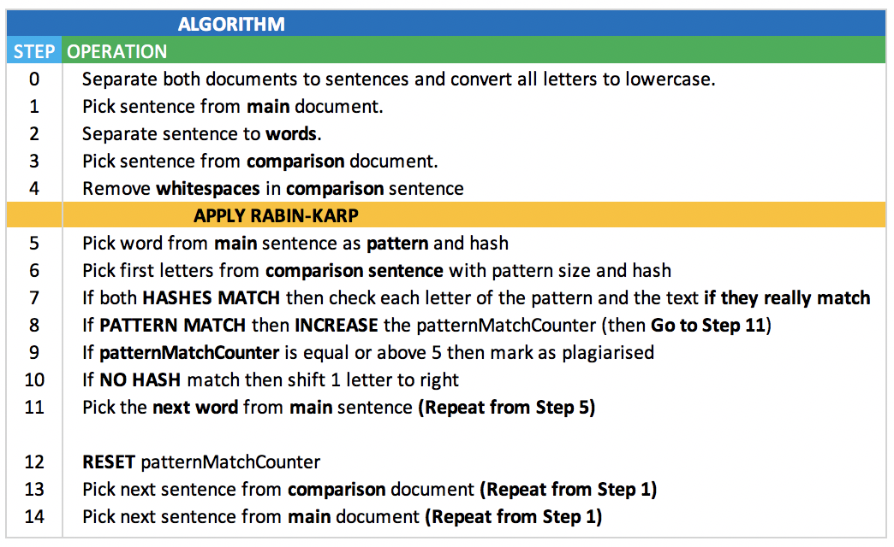
Design of the Algorithm

Slide 3
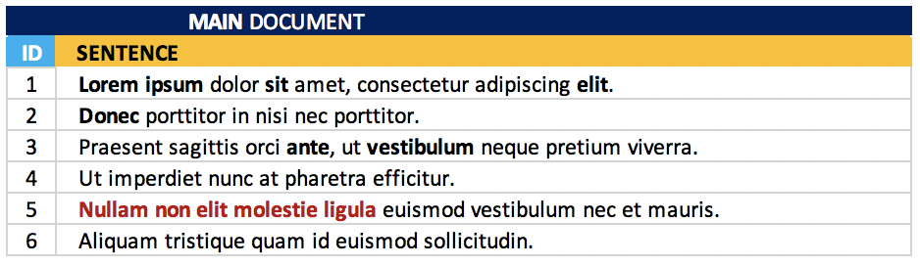
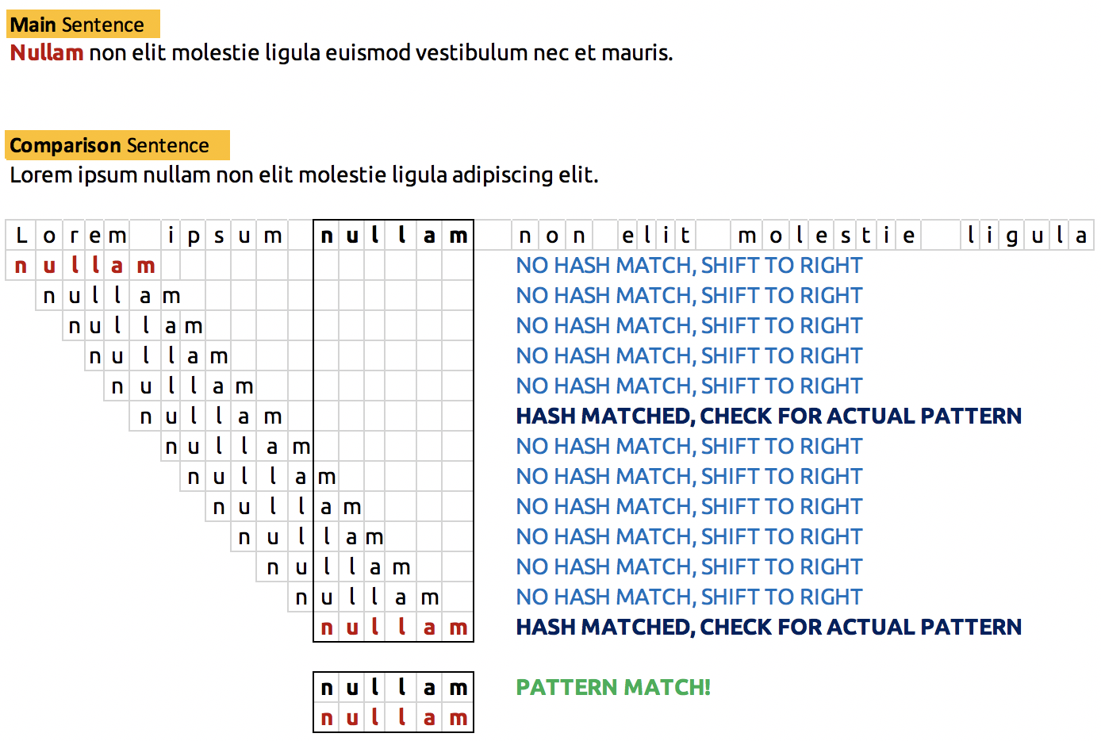
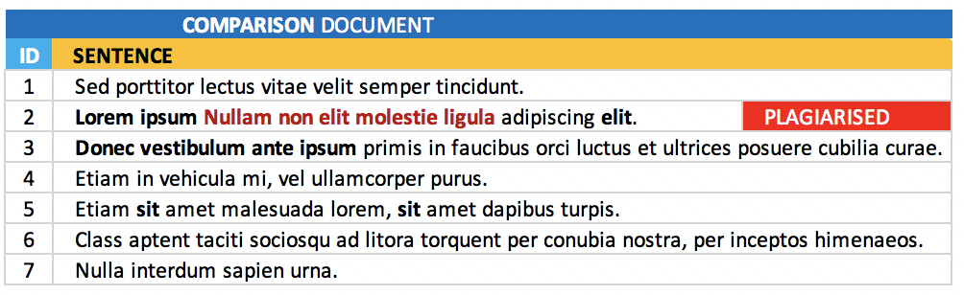
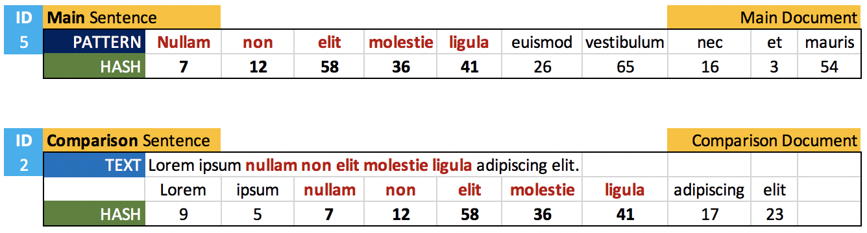
Design of the Algorithm (cont.)

Slide 4
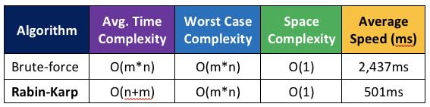

Running Time
Our first design was a naïve method (brute force) solution with O(m*n) complexity.
However, with the implementation of Rabin-Karp string searching algorithm, at the end we managed to achieve O(n+m) complexity with 501ms average execution time.
*Average execution time calculated for a single main document and three comparison documents.

Slide 5
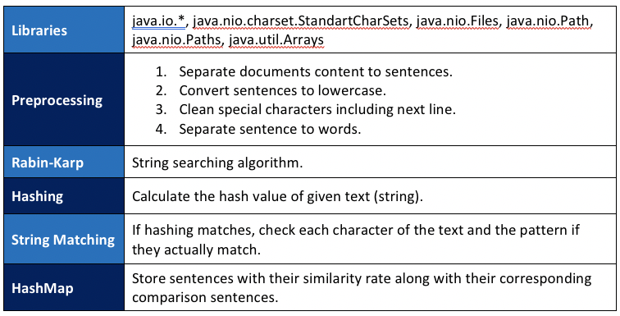
Libraries & Methods

Slide 6
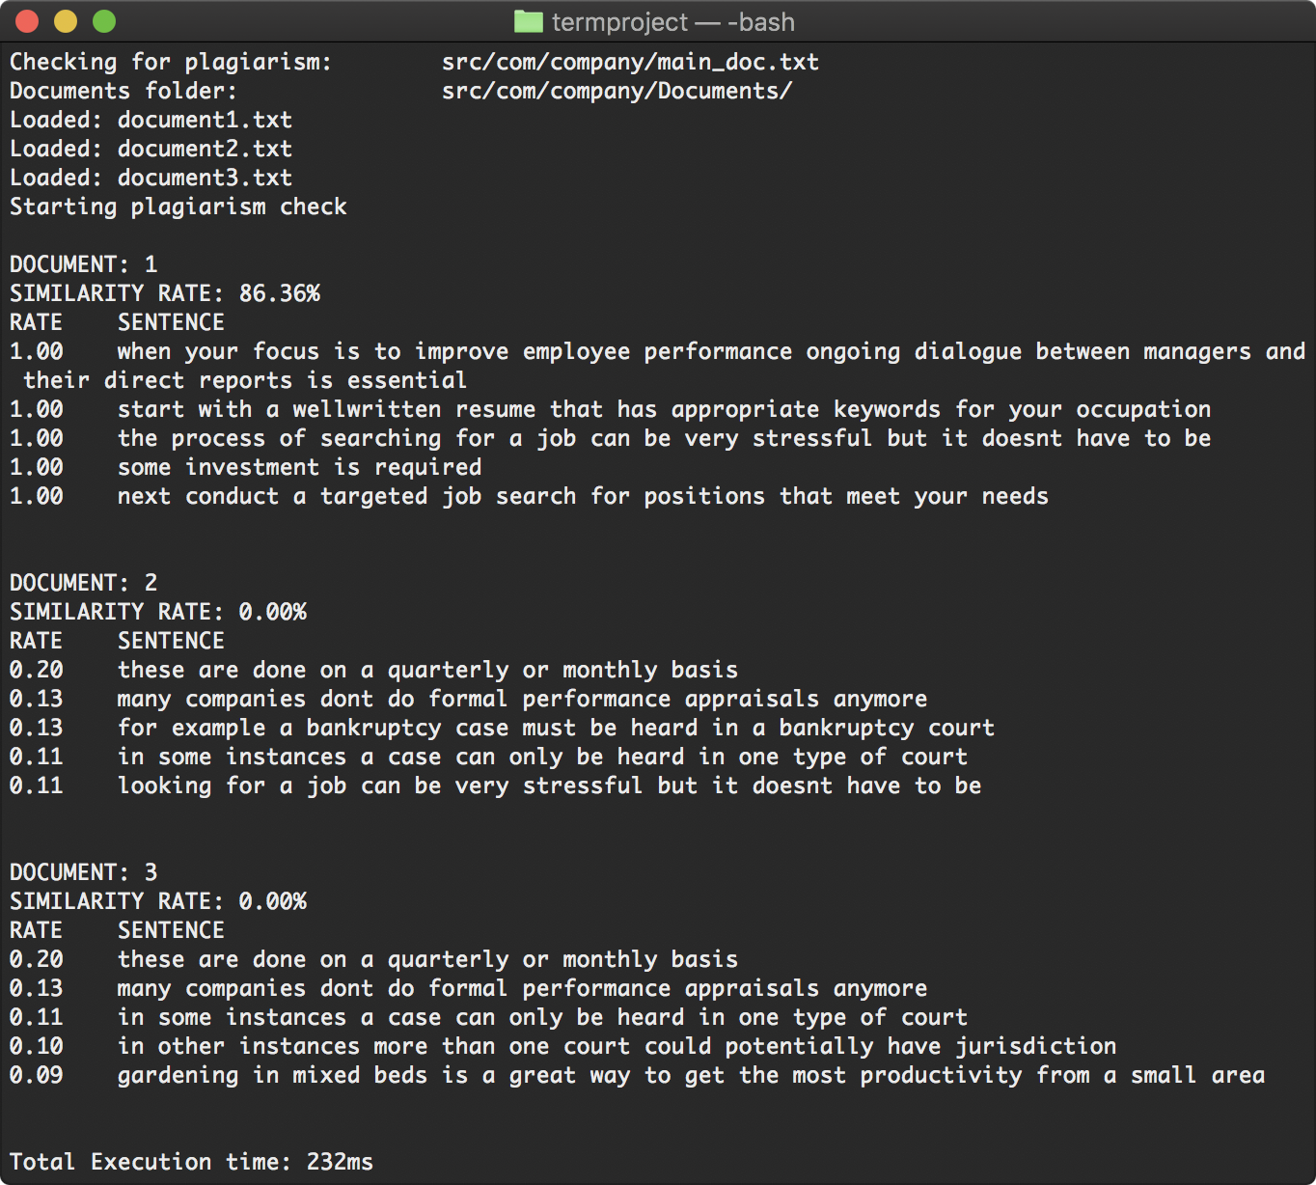
Exemplary Output
Example output of the program for a single main document and three comparison documents.

Slide 7
Thank You! Questions?

